Slide 1
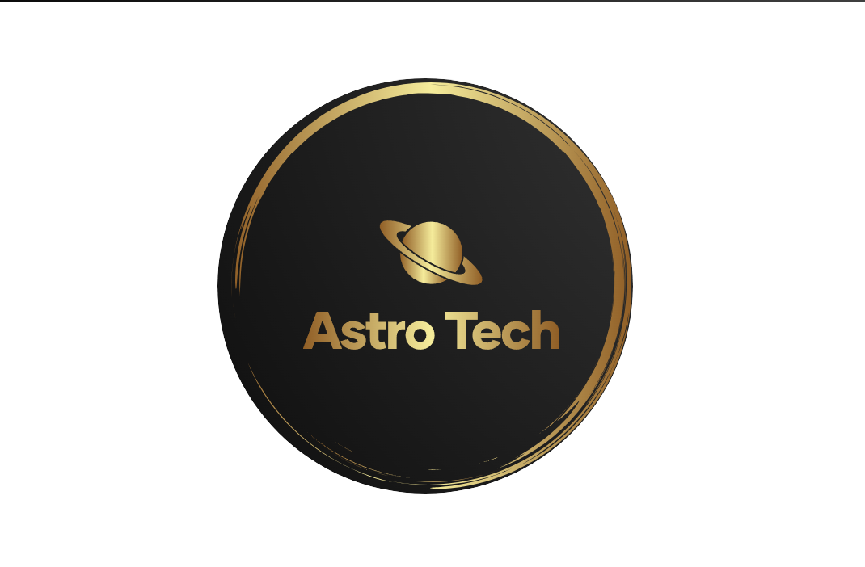

ASTRO TECH
Team Members:
1-leader: Mohamed AbdElkadir Mohamed
2- Researcher: Mohamed Elsayed Mohamed
3- Web development: Karim Mohamed Nady’
4- Researcher: Yassin Eslam Ibrahim
Our challenge is:
Symphony of the Stars: Harmonizing the James Webb Space Telescope in Music and Images

Slide 2
Our team “Astro Tech” is working on a project that will help a lot of people by illustrating them to the space technology and telescopes.
Our plan to help people is making a website on the internet and we will provide an illustrative video that will show the importance of the JWST.

Slide 3
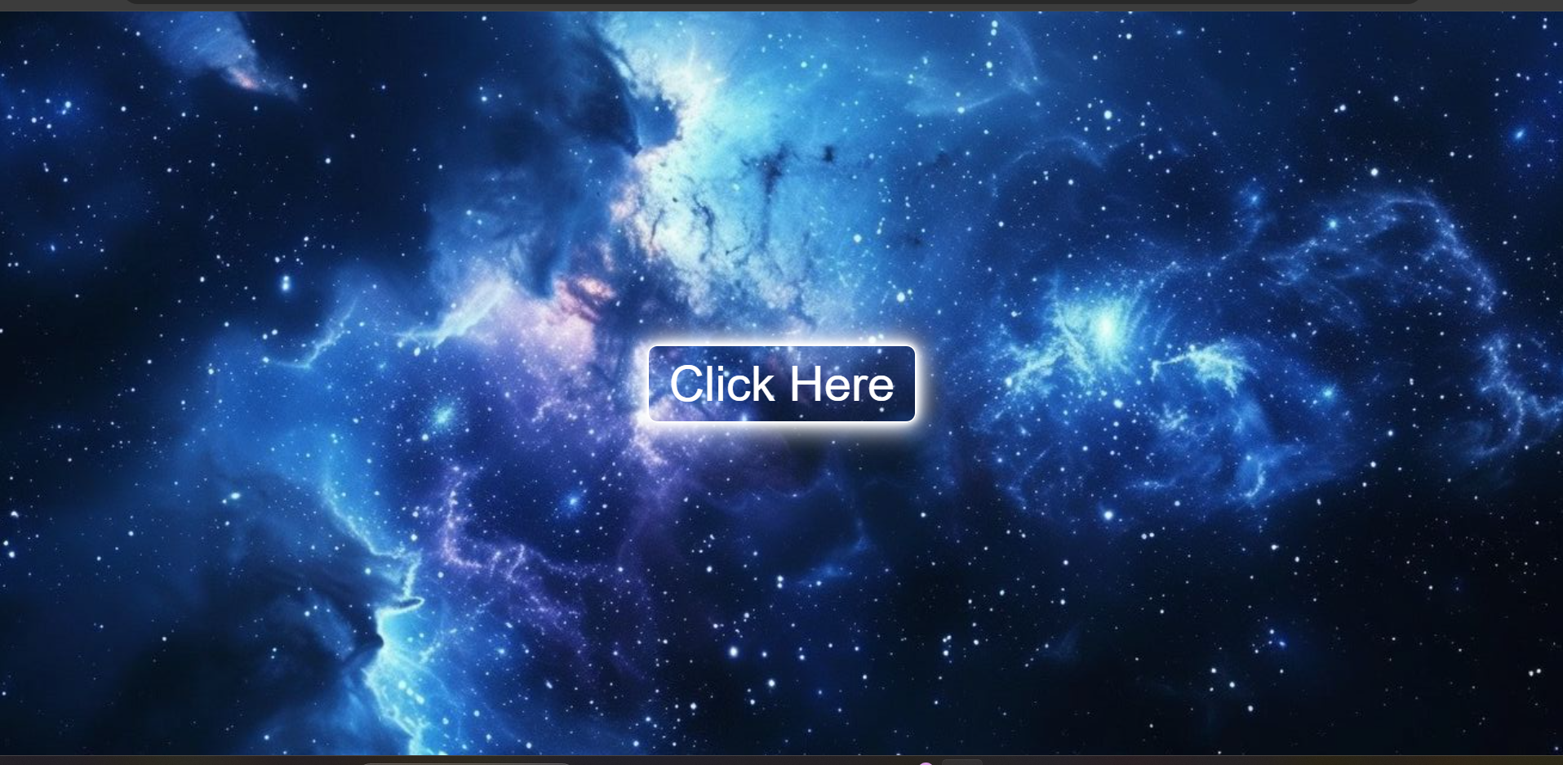
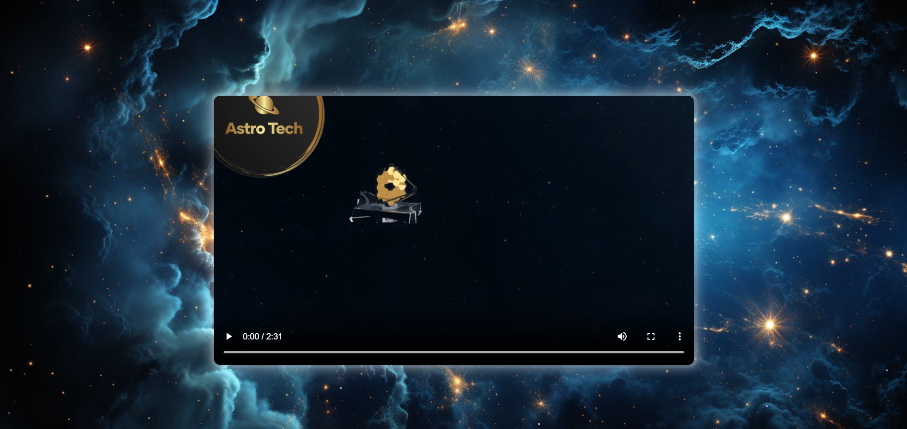
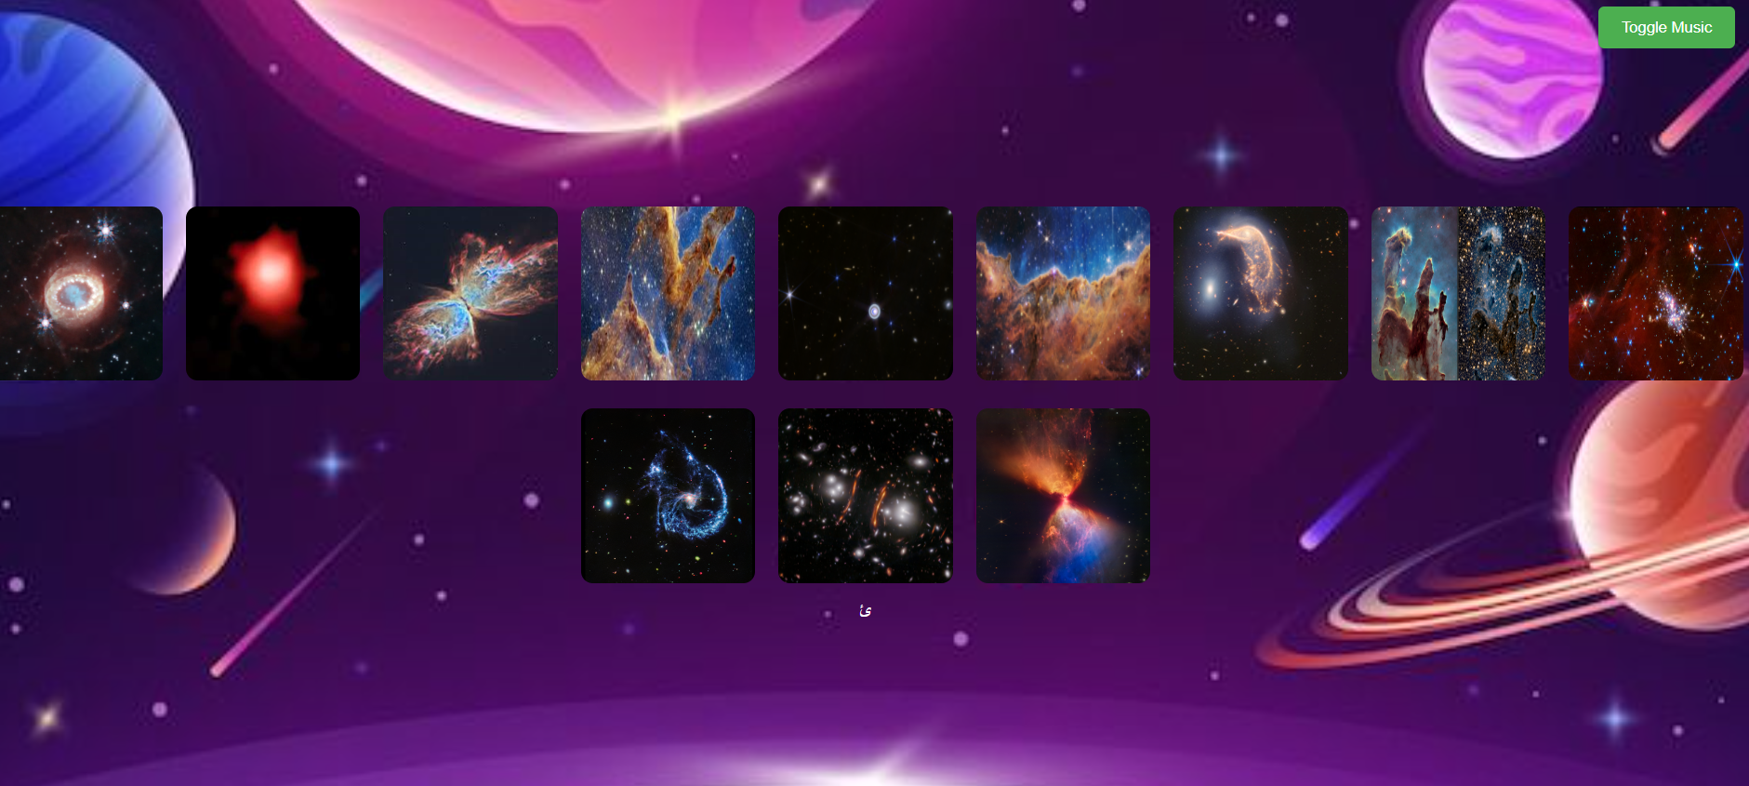
Our video and website will be made by a way that can attract the audience due to: - The easy explanation - The beautiful images that was captured by JWST - The easy usage of the website - Some articles about some cosmic phenomena
Our Website

Slide 4
We used the search to collect photos and information about James Webb Space telescope and we used the search to know the best way the people can get the information to present in our website
References: 1-https://tickets.amnh.org/select
2-https://science.nasa.gov/mission/webb/multimedia/images/#2023-Images
3-https://iopscience.iop.org/article/10.3847/2041-8213/ad54c7/meta
4-https://www.flickr.com/photos/nasawebbtelescope/52259192381/in/album-72177720301006030/
5-Top 10 Hubble images | Nature

